Slide 1
SOC with IoT applications (EC667) Faculty Name : Dr. Rajib Malik

Slide 2
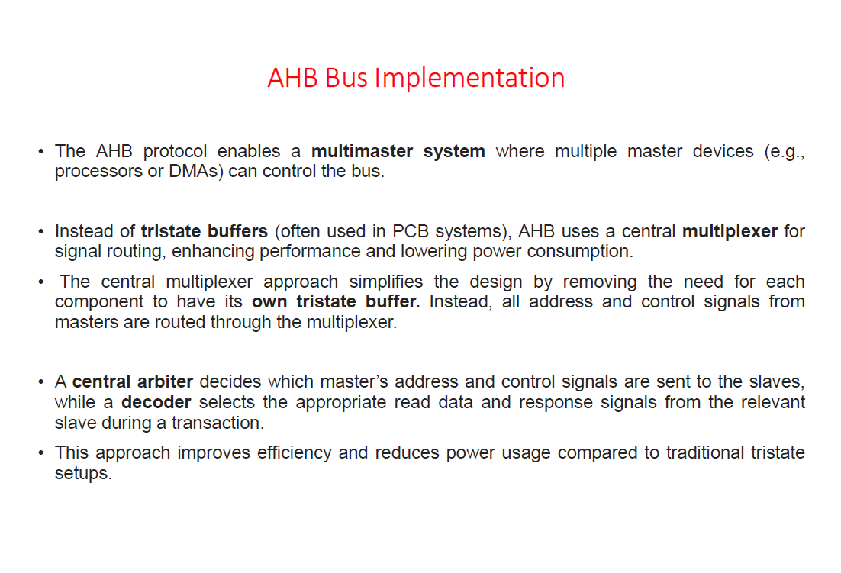

Slide 3
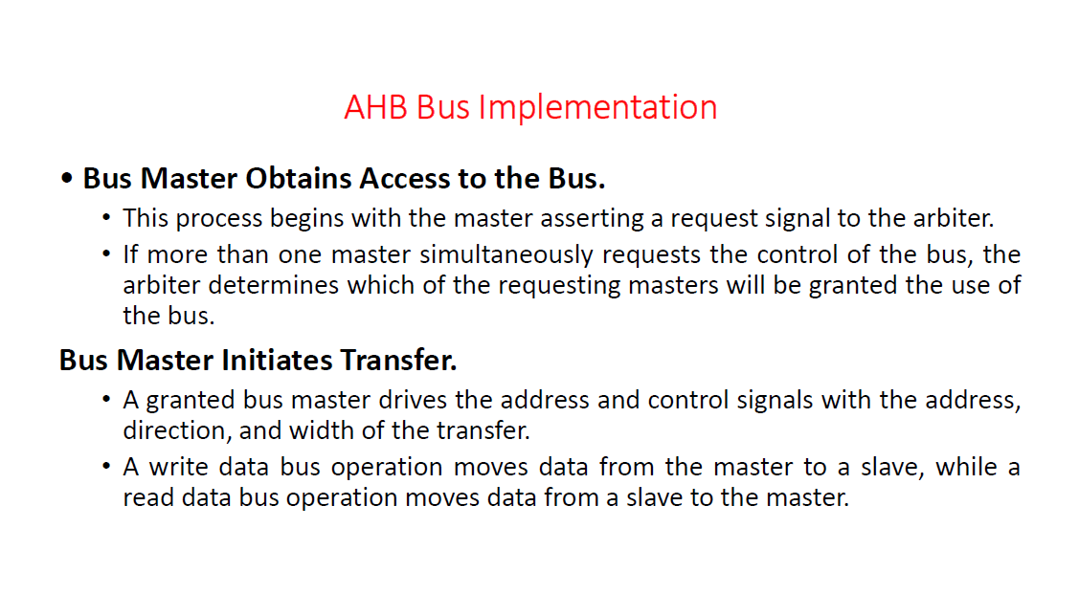

Slide 4
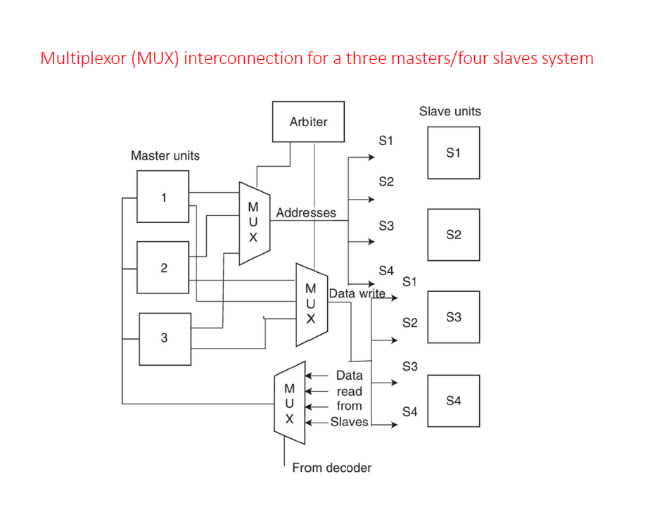

Slide 5
AHB Transfer Cycle
An AHB transfer cycle consists of two main phases:
Address Phase: The master asserts the address (ADDR) and control signals on the rising edge of the clock (CLK), and this phase lasts a single cycle.
Data Phase: The slave responds to the address and control signals from the master by reading (RDATA) or writing (WDATA) data. During this phase, the slave sends a READY signal when it completes the operation.

Slide 6
States for AHB Transfer Cycle
Wait States:
If the slave needs more time to complete the data transfer, it can delay the operation by withholding the READY signal. This creates wait states, which prolong the data phase until the slave is ready.
Write and Read Operations:
Write Operation: The master keeps the data stable until the data phase completes.
Read Operation: The slave only sends valid data in the final cycle of the data phase, ensuring accurate data transfer.
Pipelining:
The AHB bus is pipelined or tenured, meaning that the address phase of a new transfer can occur at the same time as the data phase of the previous transfer.
This overlapping feature enhances speed by allowing consecutive operations without waiting for the prior transaction to fully complete, making the AHB bus ideal for high-performance applications.

Slide 7
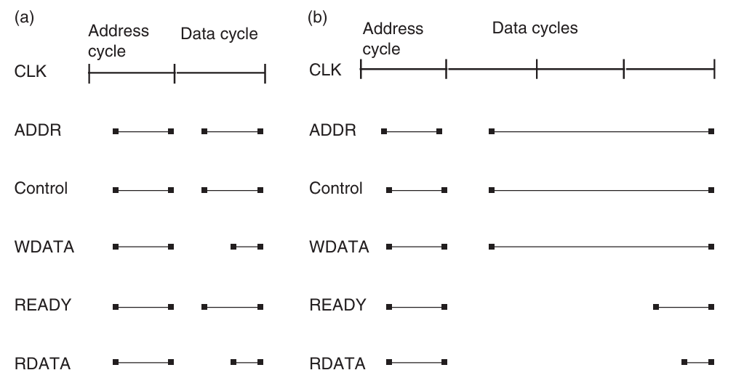
AHB Transfer Cycle
A simple AHB transfer [22] . (a) No wait states in transfer; (b) with wait states during transfer

Slide 8
APB Transfer Cycle
Optimized for Simplicity and Low Power:
Unlike the AHB, the APB is optimized for minimal power usage and low complexity rather than speed. It’s designed to connect to low-bandwidth peripherals.
The operation of the APB is straightforward and can be described by a state diagram with three states.
Idle State, Setup State, Enable State.

Slide 9
APB Transfer Cycle
Idle State: The bus remains idle when there’s no ongoing data transfer.
Setup State: When a transfer begins, the bus enters the setup state, preparing for data transfer.
Enable State: In this state, the actual data transfer occurs. After completion, the bus either goes back to the Idle state or loops through Setup and Enable states for additional transfers.

Slide 10
CoreConnect vs. AMBA
CoreConnect is compared to AMBA(Advanced Microcontroller Bus Architecture), as both provide a standardized SoC bus hierarchy to manage different performance and complexity levels in an SoC system.
Multiple master support: Multiple components can control the bus, improving flexibility.
Separate read/write ports: Enables simultaneous reading and writing, which increases efficiency.
Pipelining, split transactions, burst mode transfer: These are advanced techniques for faster data transfer.
Extendable bus width: Allows scalability by increasing data width.

Slide 11
CoreConnect Bus Architecture
CoreConnect has a hierarchy of three buses, each serving specific purposes:
Processor Local Bus (PLB): A high-performance bus for bandwidth-intensive blocks (e.g., the PowerPC CPU, high-speed memory controllers, and PCI-X bus bridges).
On-Chip Peripheral Bus (OPB): Supports lower data rate peripherals, making it suited for less demanding on-chip components.
Device Control Register (DCR) Bus: A slower bus for configuration and status signals. The DCR bus connects to the CPU core and other modules to share status information efficiently without using high-bandwidth resources.

Slide 12
CoreConnect Bus Architecture
In a typical SoC using CoreConnect, High - performance, high - bandwidth blocks such as the PowerPC 440 CPU core, the PCI - X bus bridge, and the PC133/ DDR133 (DDR1 with a 133 MHz bus) synchronous dynamic RAM (SDRAM) Controller are connected together using the PLB.
The OPB hosts lower data rate on - chip peripherals.

Slide 13
Processor Local Bus (PLB)
Purpose and Features: The PLB is optimized for high-bandwidth, high-performance, and low-latency data transfers. It connects critical components like processors, memory, and DMA controllers, facilitating fast data movement.
It’s a synchronous, split-transaction bus, meaning it can handle separate address, read, and write buses, which allows two transfers per clock cycle.
Each master on the bus (like a processor or DMA controller) has its own set of control and data signals, while slaves share common buses.

Slide 14
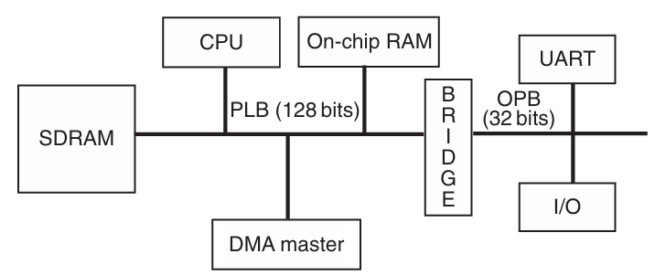
A CoreConnect - based SOC

Slide 15
Processor Local Bus (PLB)
Transaction Phases: Similar to AMBA AHB, PLB transactions include multiple phases that may span multiple clock cycles.
Address Phases: Each address bus transaction has three phases:
Request (RQ): The master initiates the transaction by requesting control of the bus.
Transfer (XFER): Once granted by the arbiter, the address and control signals are sent to the slave.
Acknowledge (ACK): The transaction concludes when the slave device acknowledges the address.
Data Tenure Phases: Each data transfer phase involves a transfer and an acknowledgment, with each data beat coordinated with the address cycle.

Slide 16
Processor Local Bus (PLB)
Split Transaction Capability:
Because the PLB decouples the address, read, and write buses, it supports split transactions. This allows multiple masters to operate concurrently on different buses.
Through address pipelining, one master can begin an address request even while another master is completing a data transfer, enhancing efficiency and reducing wait times.

Slide 17
On-Chip Peripheral Bus (OPB)
Purpose and Features: The OPB serves as a secondary, lower-performance bus intended to connect lower-bandwidth peripherals, reducing the load on the PLB and thereby boosting system performance.
It’s suited for peripherals like serial ports, parallel ports, UARTs, GPIO, and timers.
It is more sophisticated than AMBA’s APB, with support for multiple masters and slaves via a distributed multiplexer structure.
This design allows peripherals to connect to the OPB without altering the bus structure.

Slide 18
On-Chip Peripheral Bus (OPB)
Bus Control Signals:
Both OPB masters and slaves have control signals for enabling or disabling the data buses, allowing for flexible data flow and integration of additional peripherals.
The structure allows masters to send addresses to slaves and for data to flow in both directions on the distributed data bus.

Slide 19
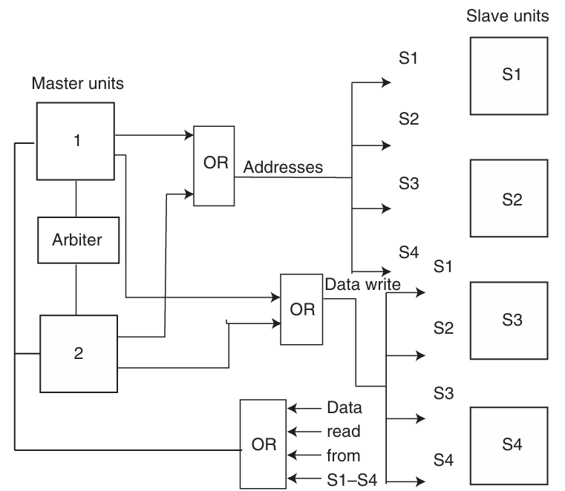
The on - chip peripheral bus (OPB)

Slide 20
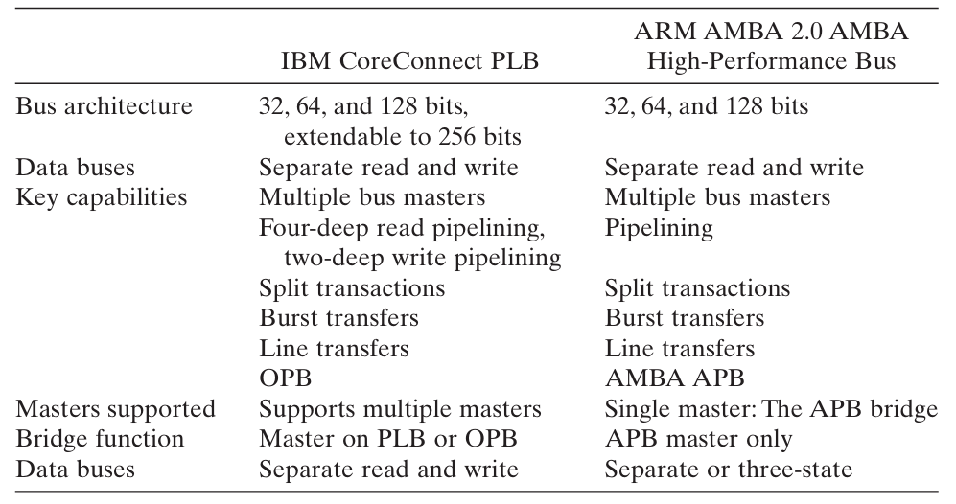
Comparison between CoreConnect and AMBA Architectures

Slide 21
Introduction to Internet of Things (IOT)
Prepared By
Prof. Sudip Mishra, IITKGP

Slide 22
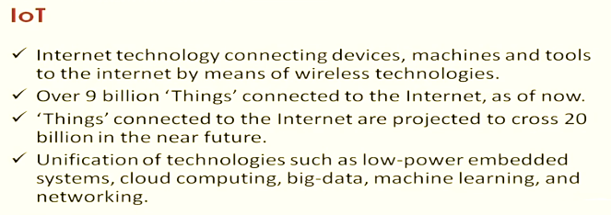

Slide 23
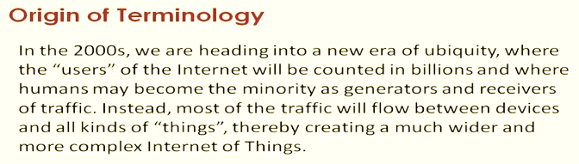

Slide 24
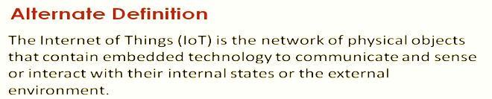

Slide 26
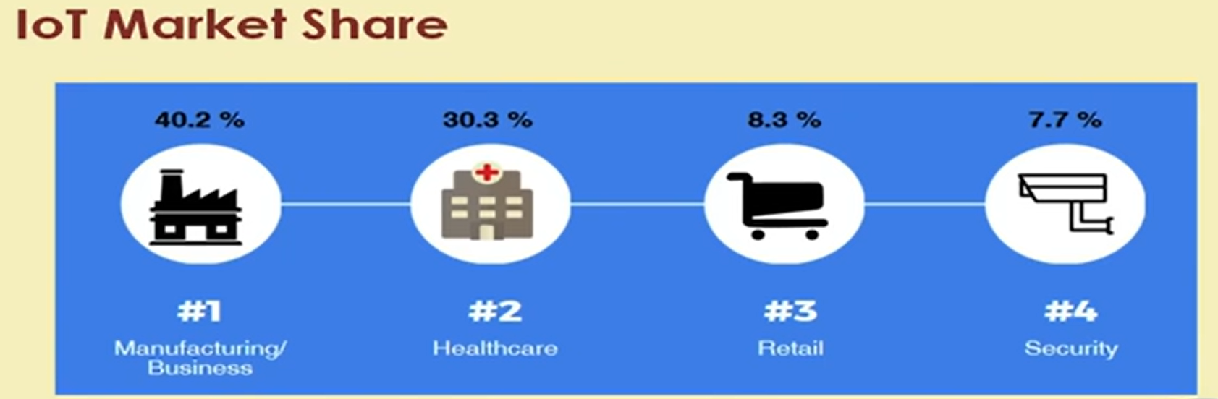

Slide 28
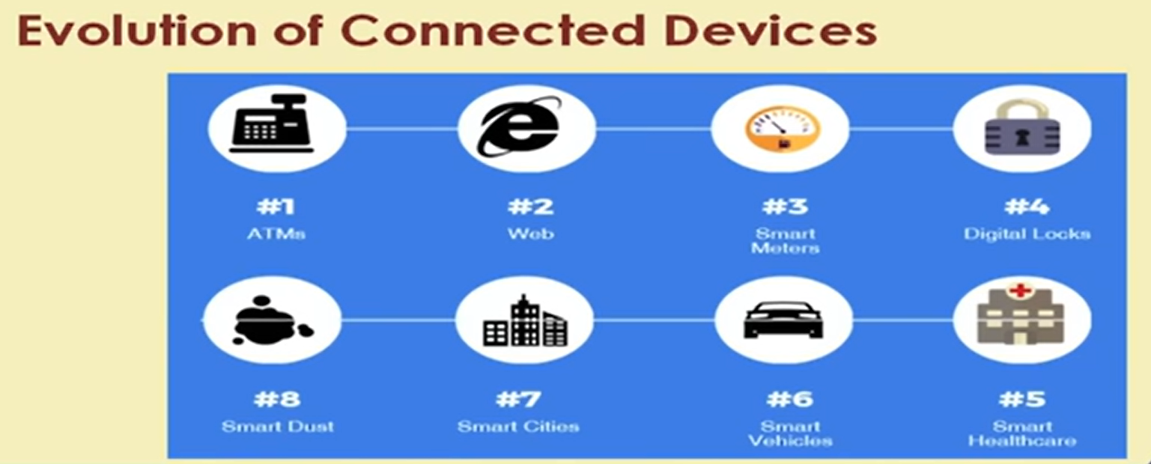

Slide 29
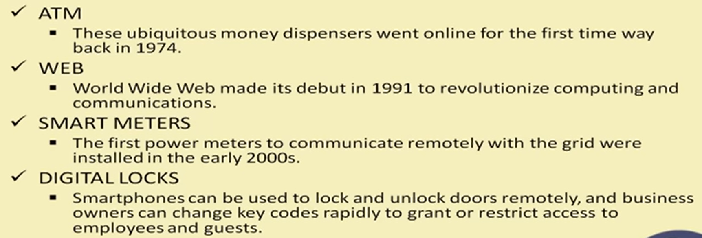

Slide 30
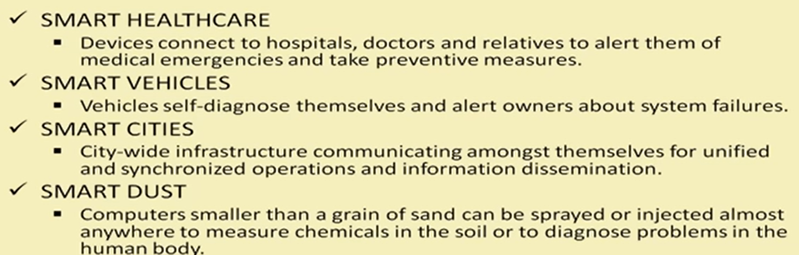

Slide 31
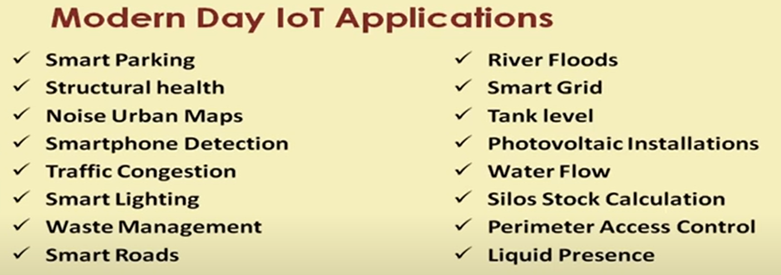

Slide 32
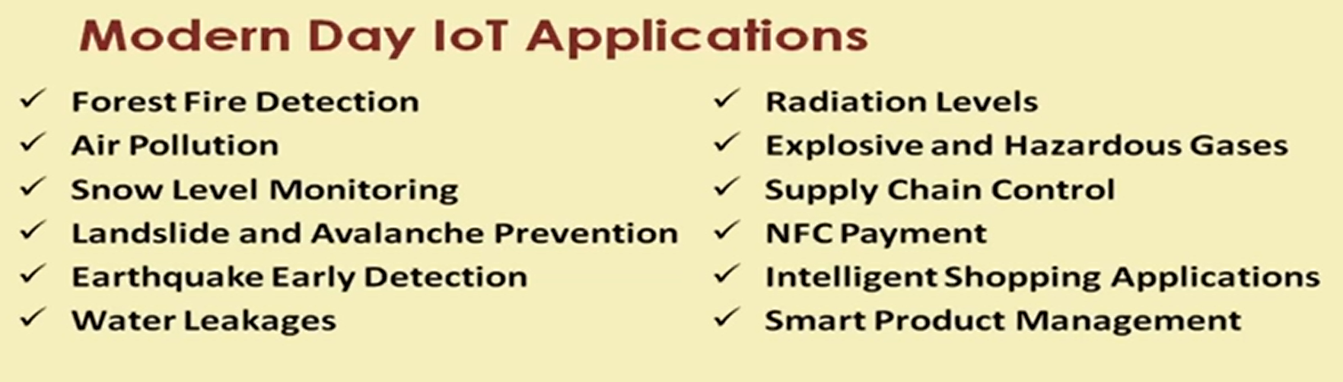

Slide 33
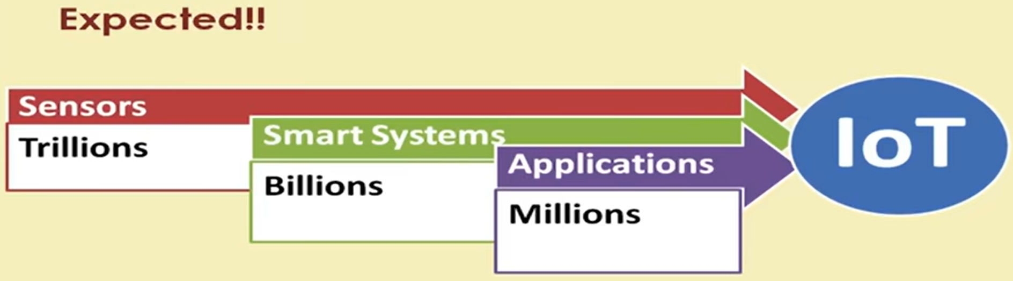

Slide 34
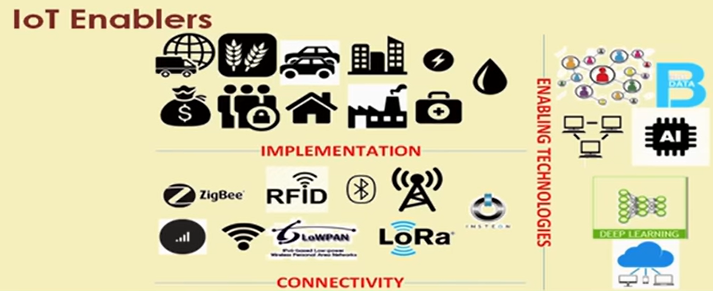

Slide 37
Cyber Physical System
Cyber-Physical Systems (CPS)
Definition: CPS are integrations of computation, networking, and physical processes. In CPS, embedded computers and networks monitor and control the physical processes, usually with feedback loops where physical processes affect computations and vice versa.
Internet of Things (IoT)
Definition: IoT refers to a network of physical objects (“things”) embedded with sensors, software, and other technologies to connect and exchange data with other devices and systems over the internet.

Slide 38
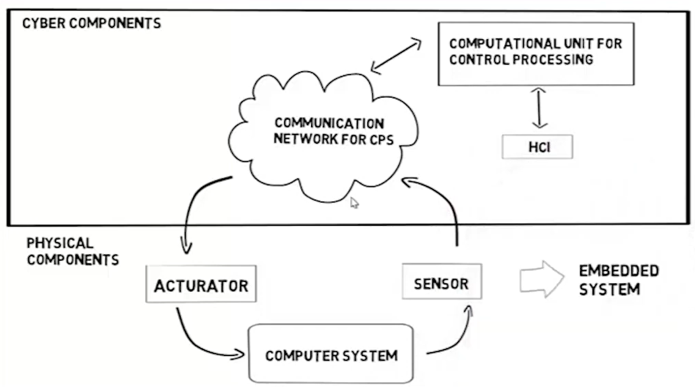
Block diagram of Cyber Physical System

Slide 39
IOT vs CSP
IOT | CSP
Focuses on connecting devices and enabling them to communicate and exchange data over the internet. | Emphasizes the integration and real-time interaction between physical and computational elements.
Primarily concerned with data collection, monitoring, and sometimes control, but not necessarily in real-time. | Often involves real-time control and feedback loops.
Encompasses a wider range of applications, including consumer electronics, smart homes, and environmental monitoring. | Typically used in critical systems requiring high reliability and precision, such as industrial automation, healthcare, and transportation.
Can vary from simple sensor networks to more complex systems but generally focuses on connectivity and interoperability. | Often has a more complex and tightly integrated architecture with real-time constraints.

Slide 40
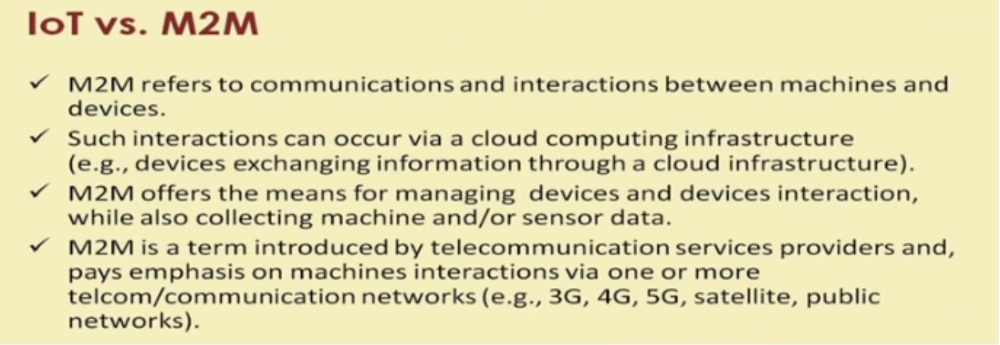

Slide 42
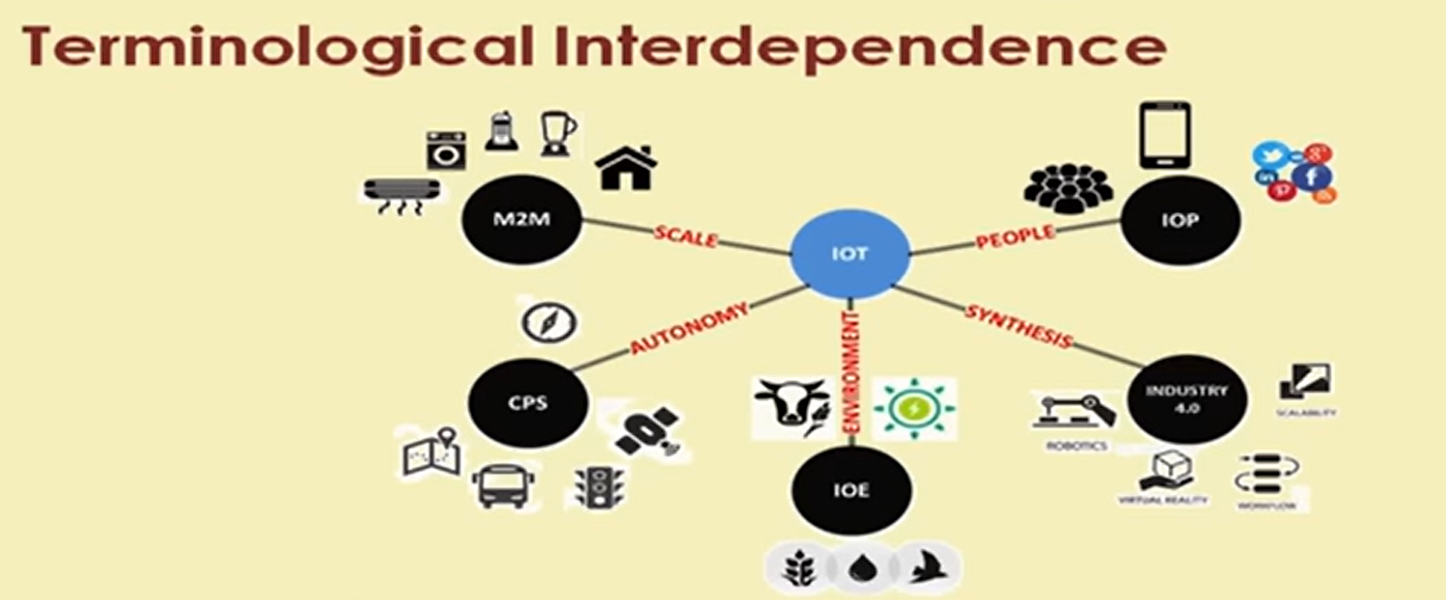

Slide 43
Sensors

Slide 44
Introduction
The Sensors are devices that responds to a physical stimulus heat, light, sound, pressure, magnetism, motion, etc , and convert that into an electrical signal.
They perform an input function
The Devices which perform an output function are generally called Actuators and are used to control. some external device, for example movement.
Transducers are devices used to convert energy of one kind into energy of another kind.

Slide 45
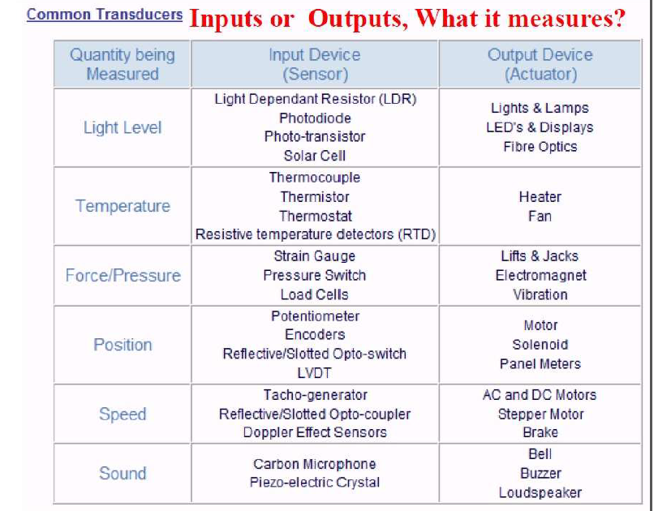

Slide 46
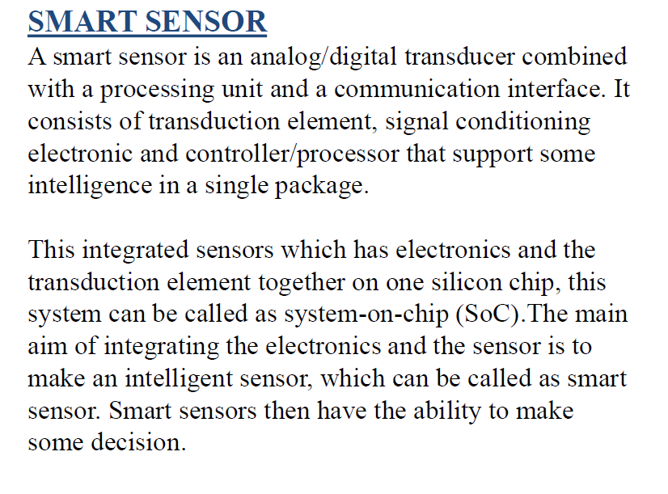

Slide 47
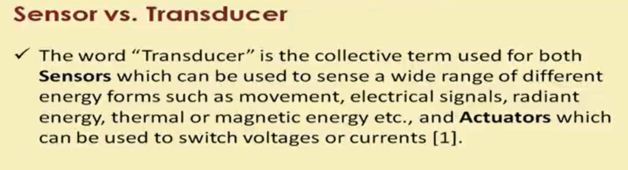

Slide 48
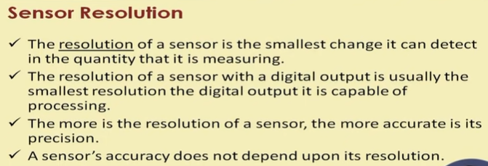
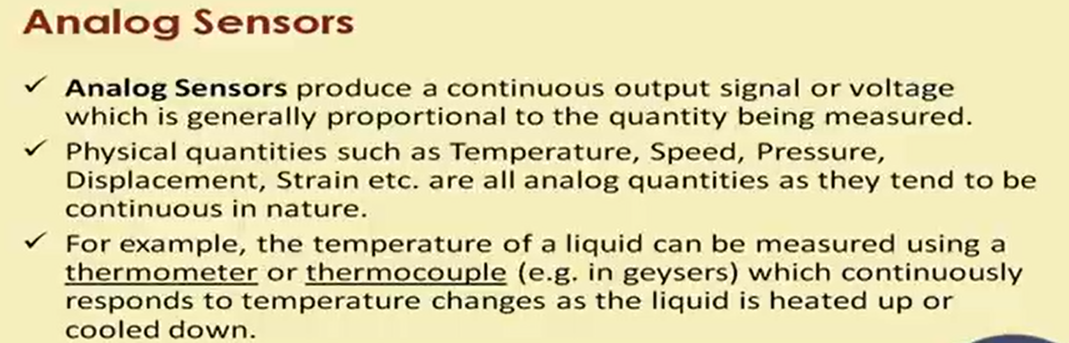

Slide 49
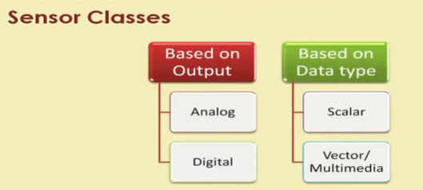

Slide 51
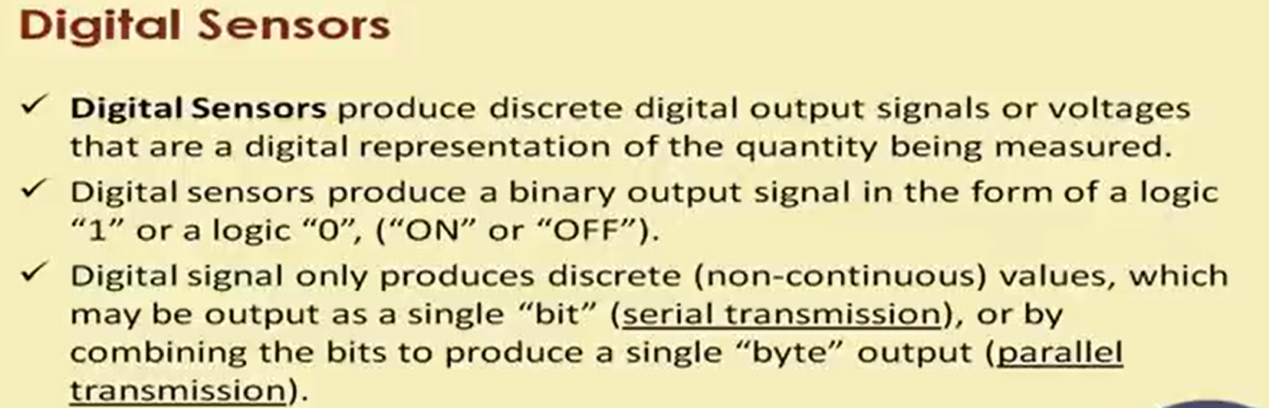

Slide 52
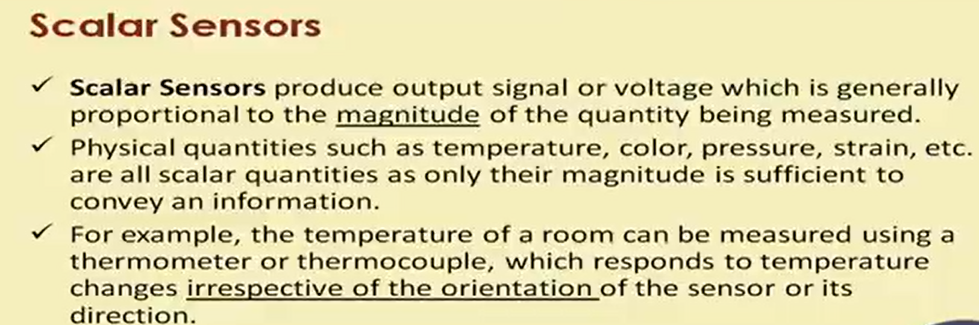

Slide 53
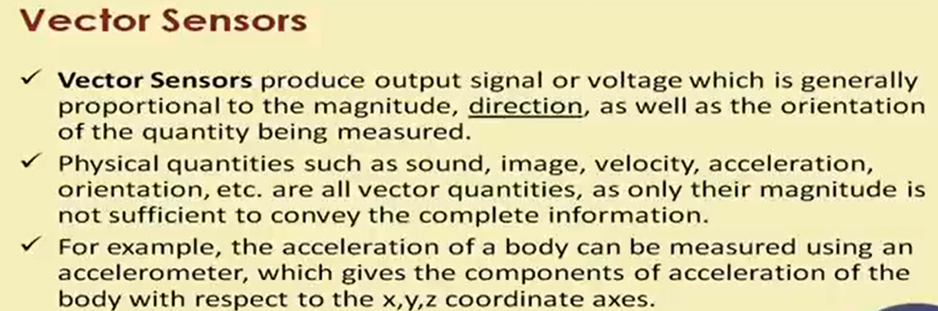

Slide 54
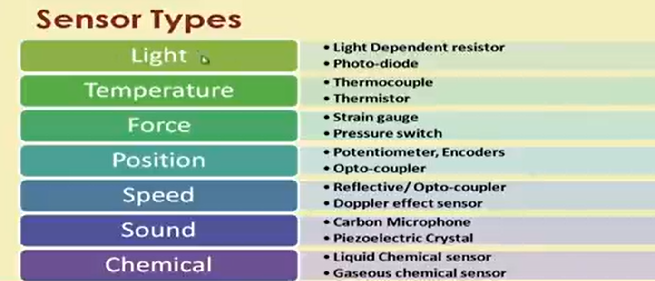

Slide 55
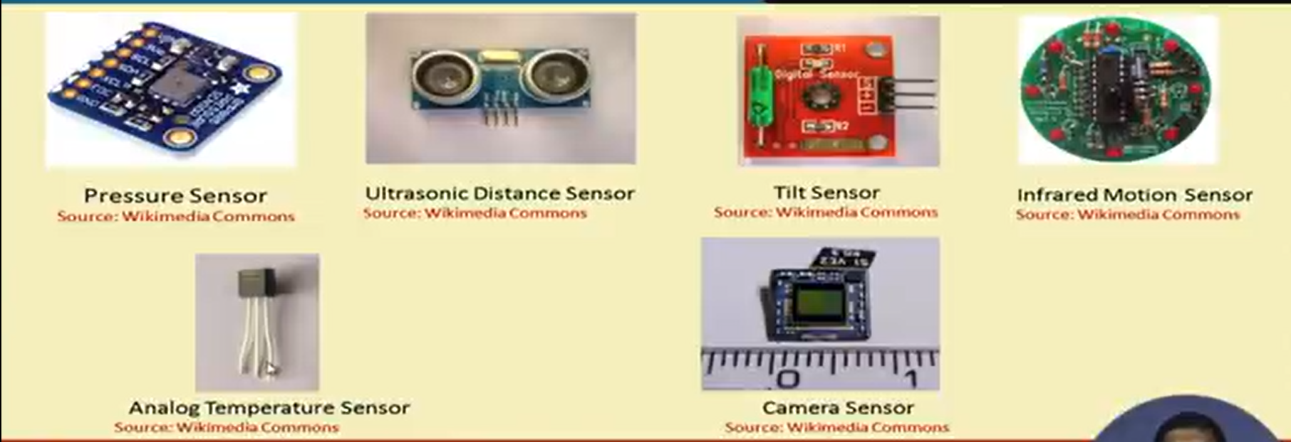

Slide 56
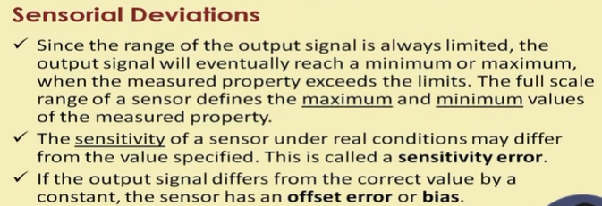
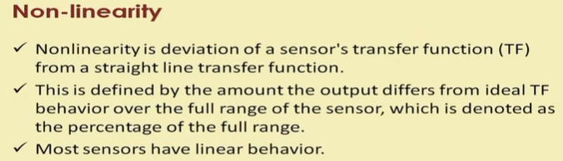

Slide 57
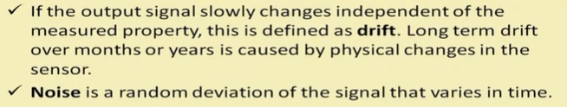
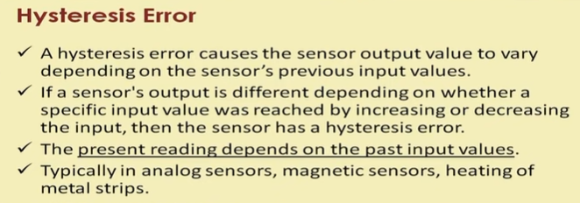

Slide 58
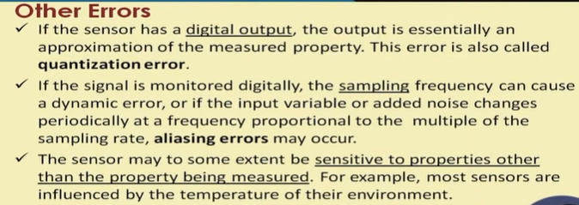

Slide 59
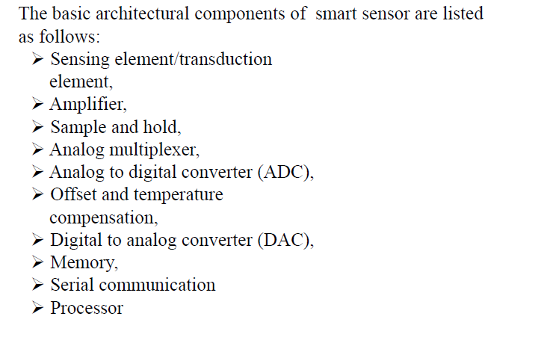
General Architecture of Smart Sensor

Slide 60
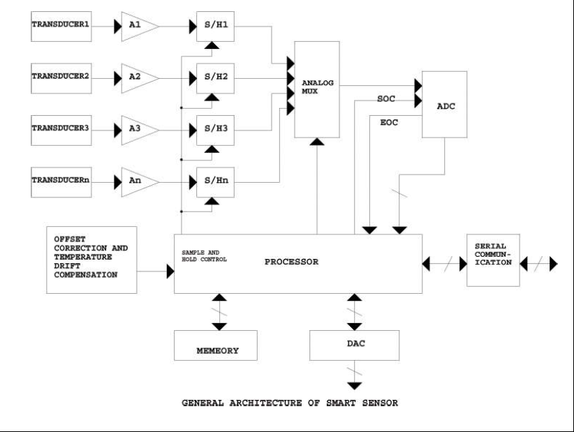

Slide 61
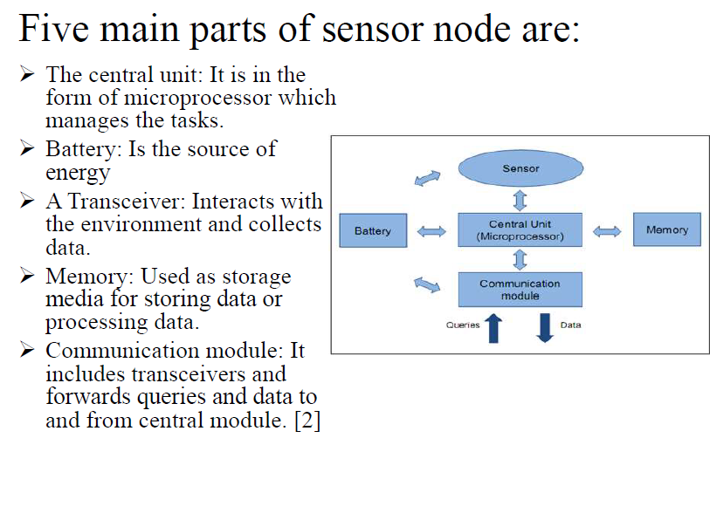

Slide 62
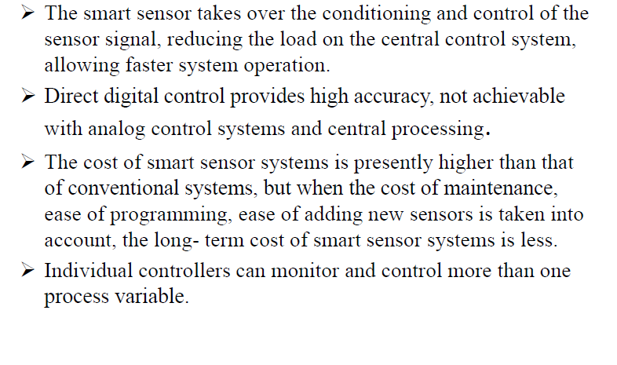
Advantage -

Slide 63
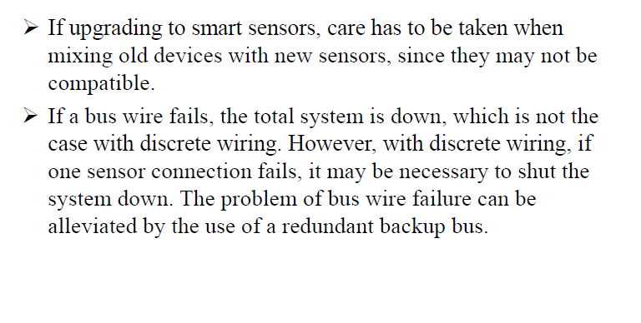
Disadvantages -

Slide 64
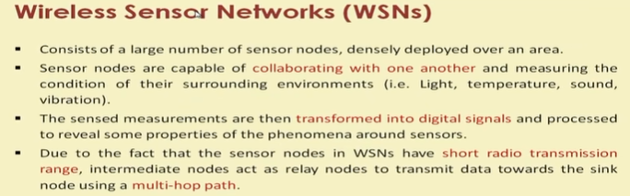

Slide 65
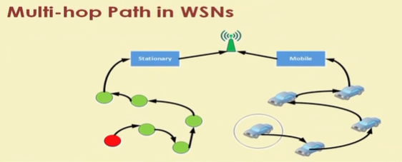

Slide 66
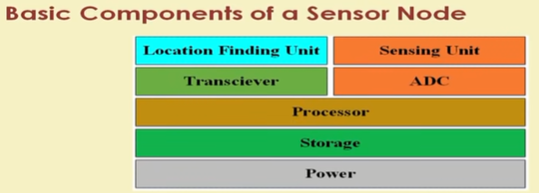

Slide 67
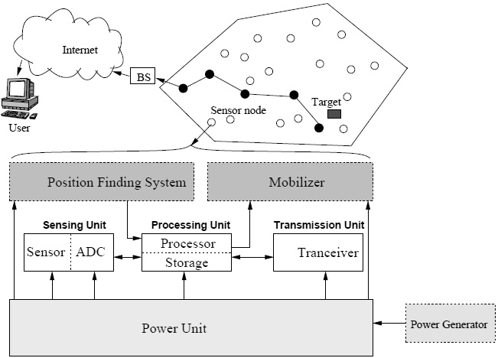
The components of a sensor node

Slide 68
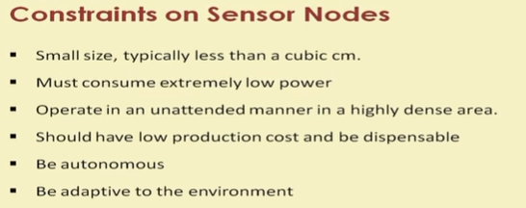

Slide 69
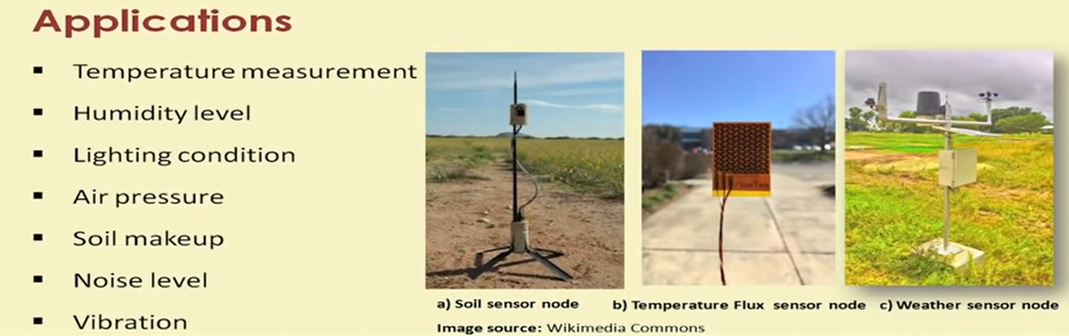

Slide 70
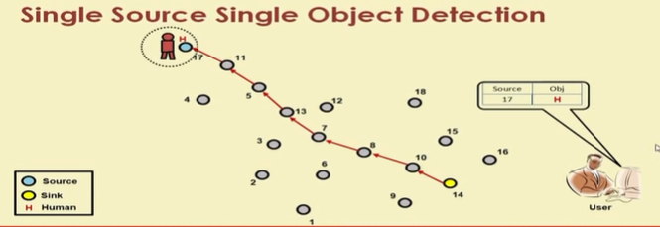

Slide 71
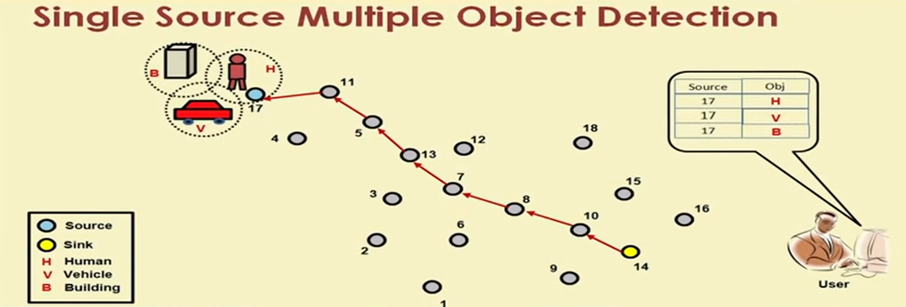

Slide 72


Slide 73


Slide 74


Slide 75



